Slide 1
Genome and Transcriptome Databases
Manpreet S. Katari

Slide 2
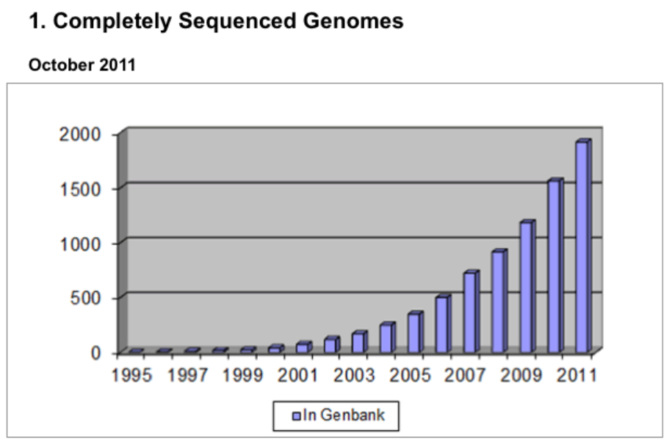
Number of genomes sequenced is increasing exponentially
http://genomesonline.org

Slide 3
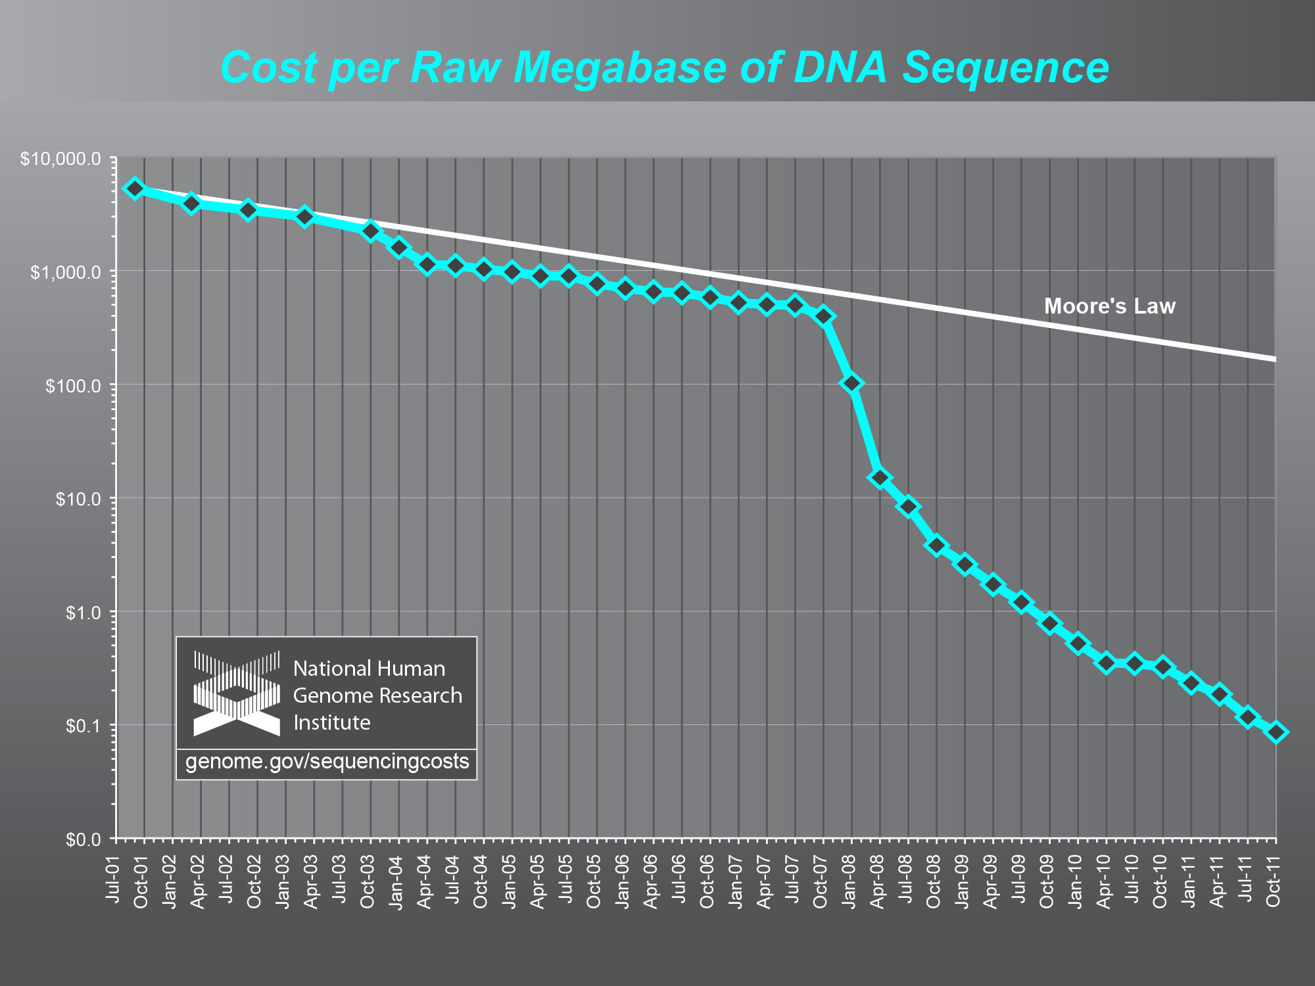
Moore’s law says every 2 years double in performance

Slide 4
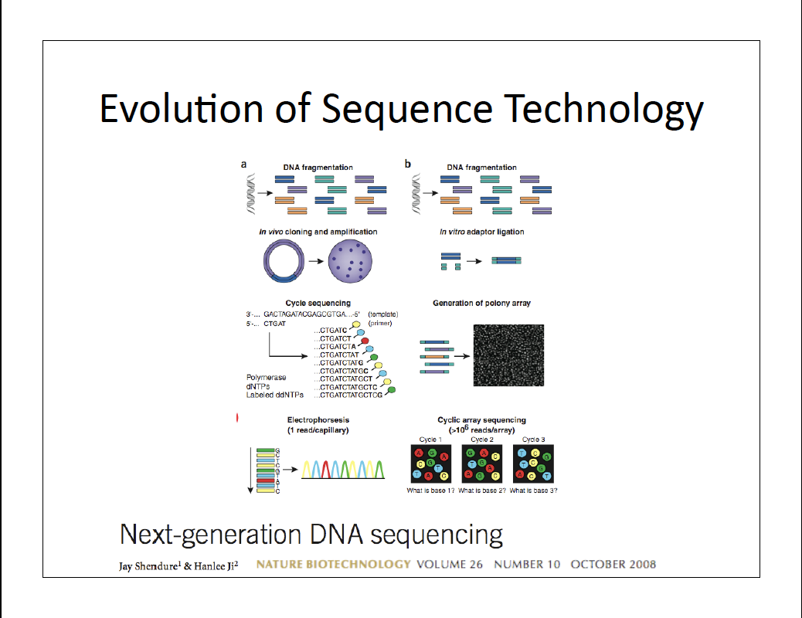

Slide 5
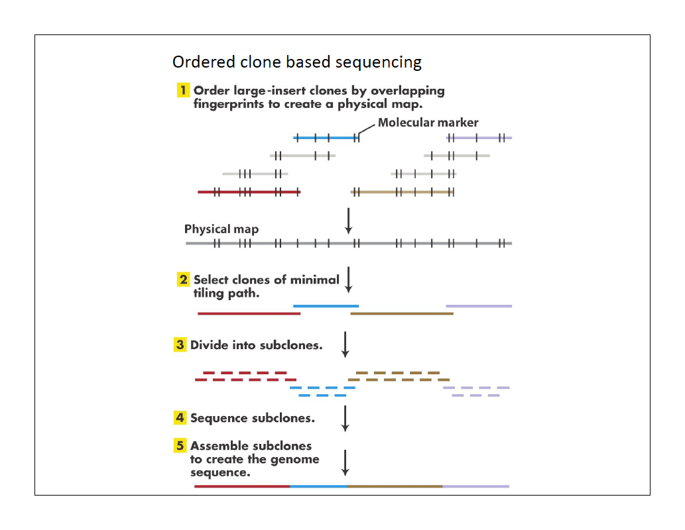

Slide 6
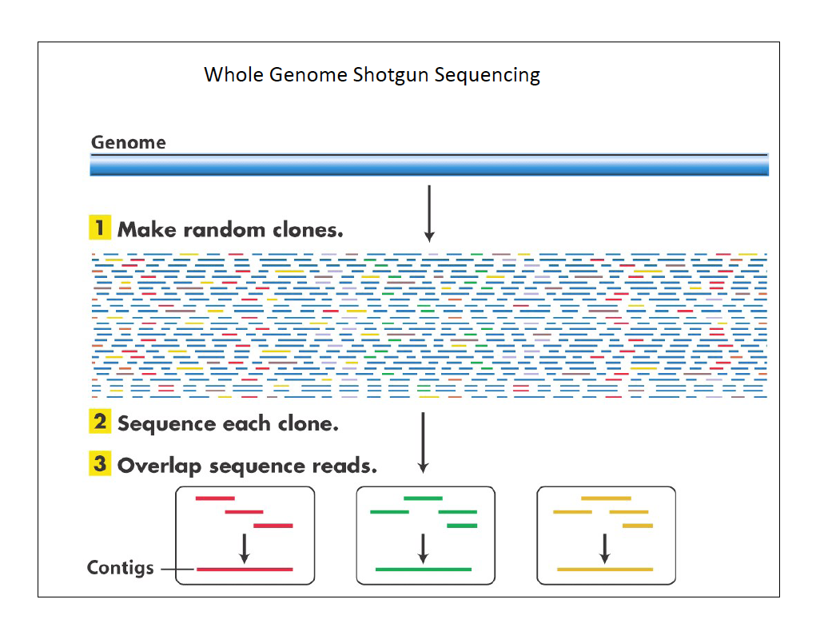

Slide 7
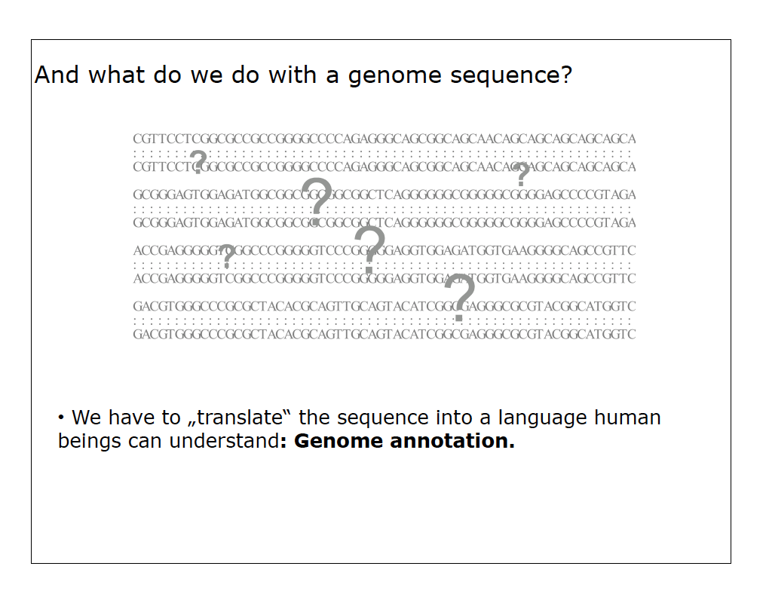

Slide 8
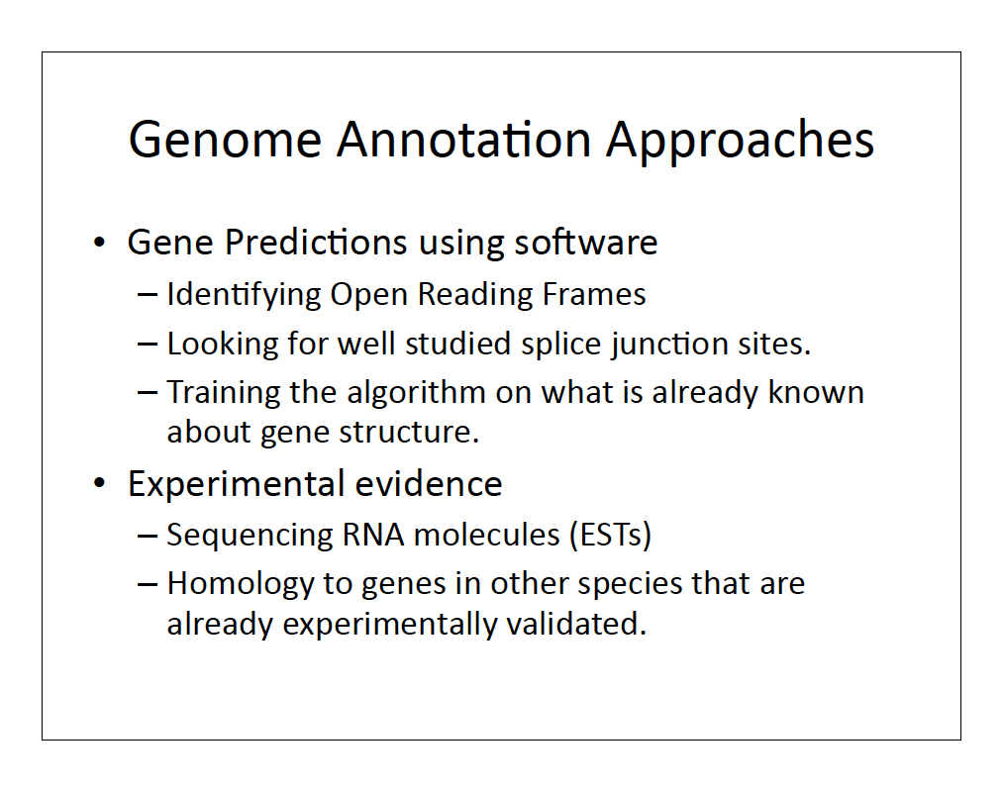

Slide 9
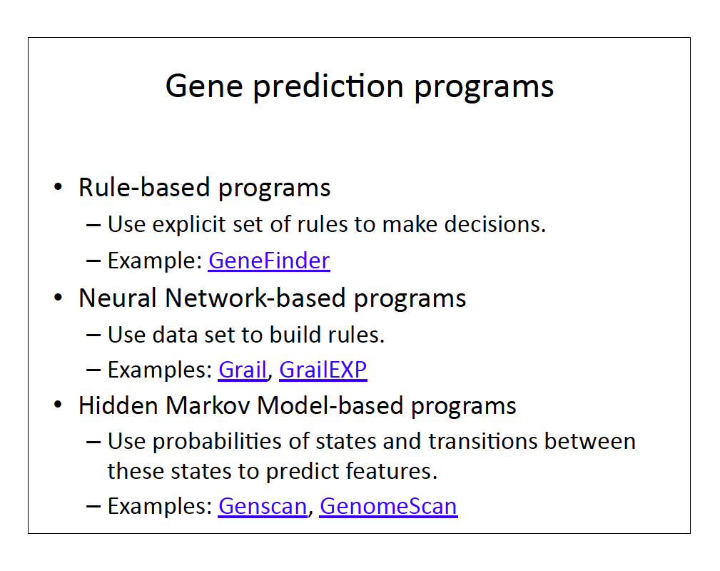

Slide 10
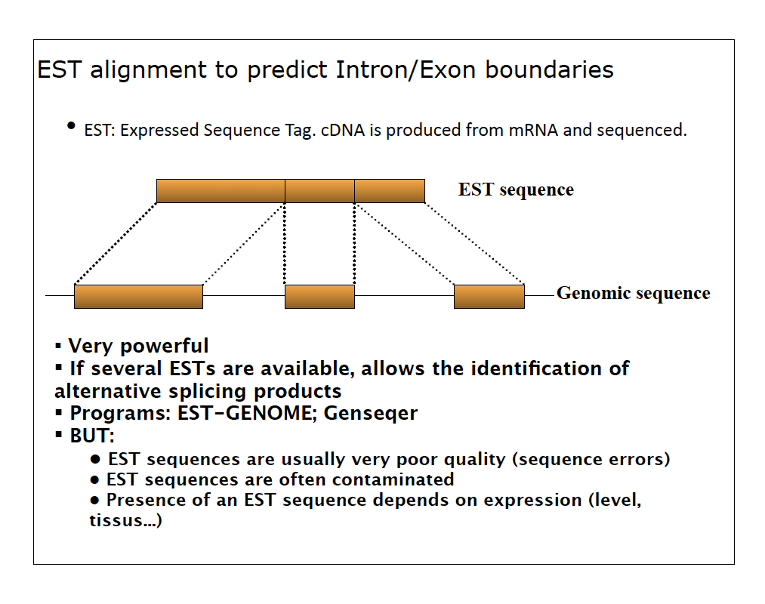

Slide 11
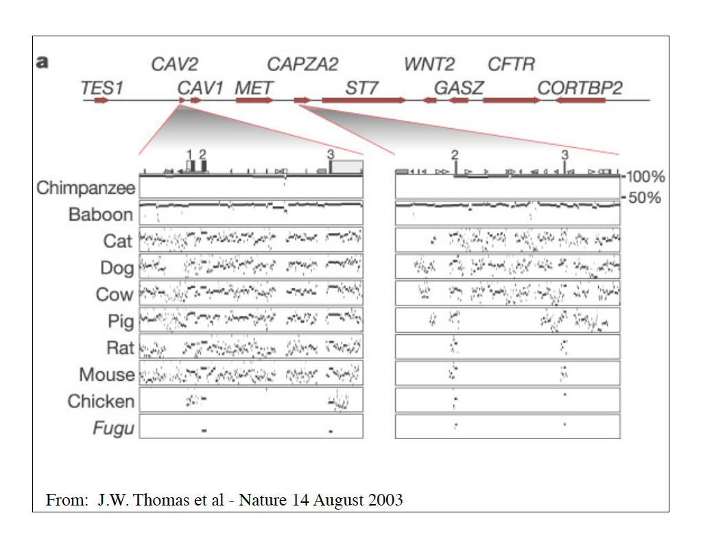

Slide 12
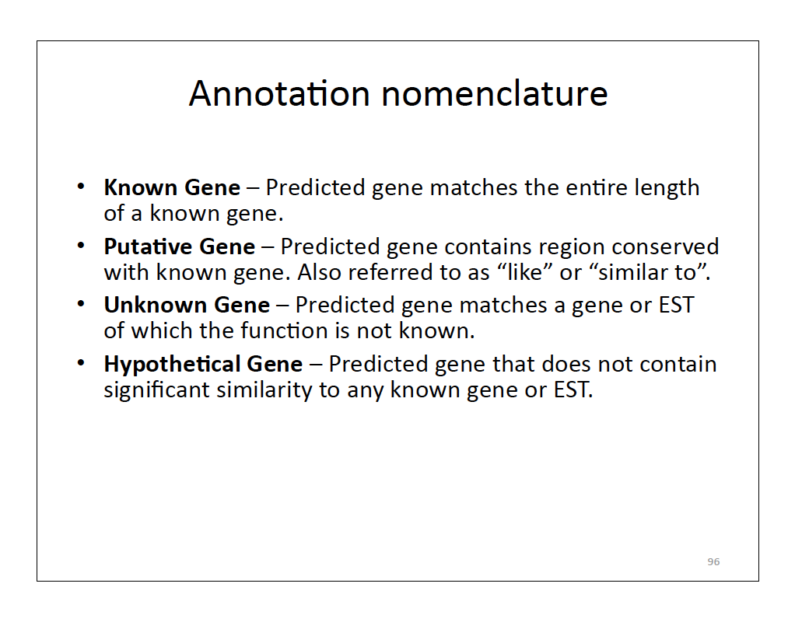

Slide 13
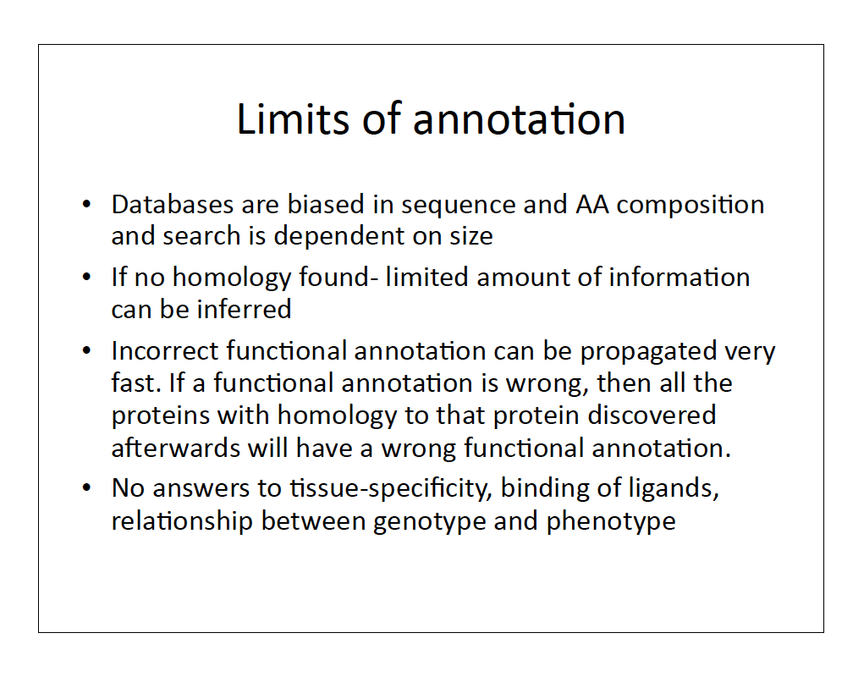

Slide 14
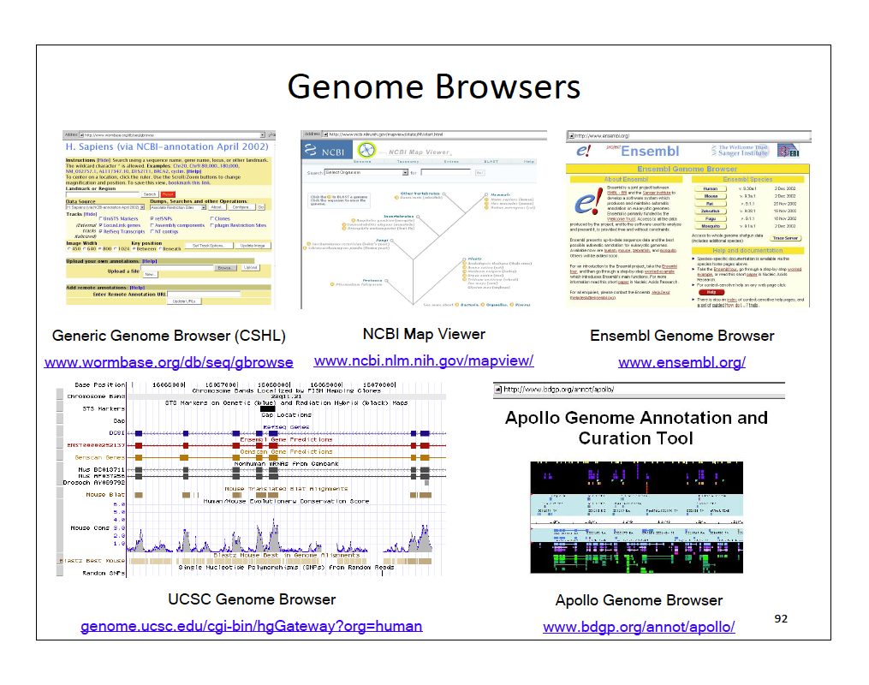

Slide 15
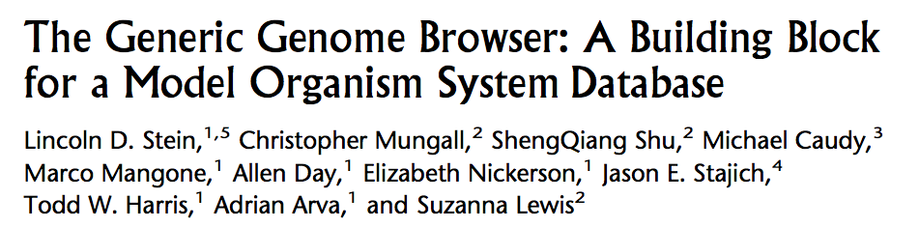
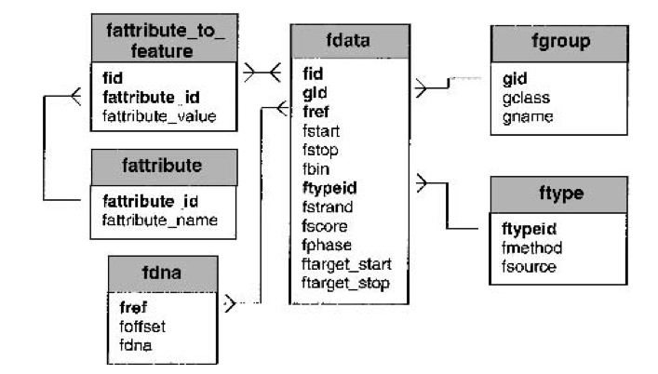

Slide 16
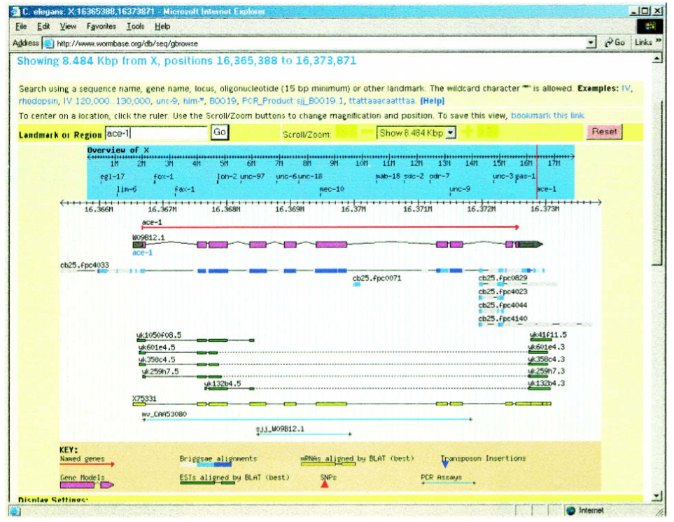
Gbrowse uses the GMOD database

Slide 17
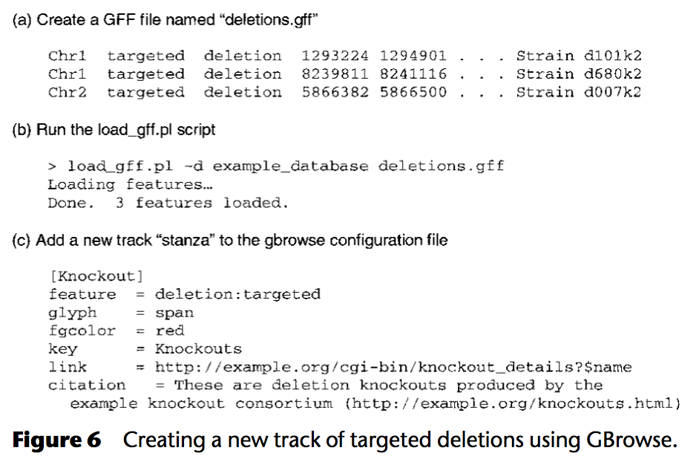
Creating the GMOD database

Slide 18
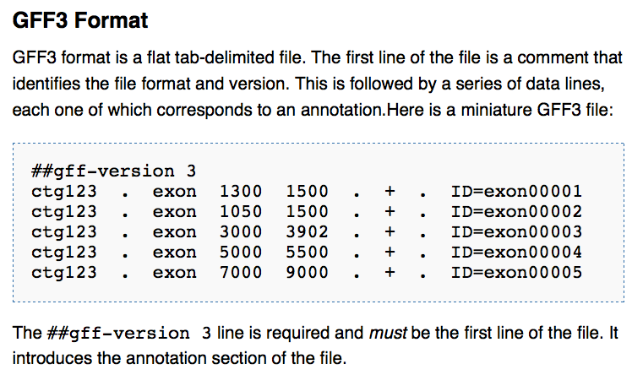
GFF format

Slide 19
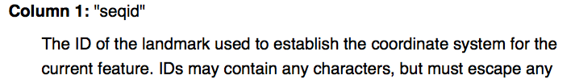
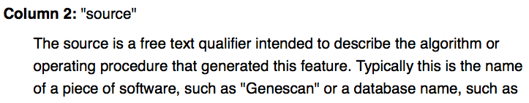
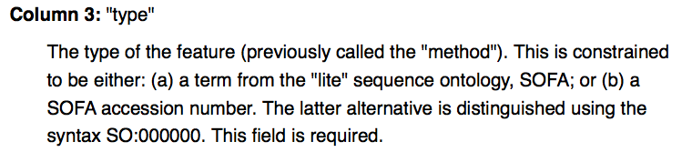
GFF columns

Slide 20
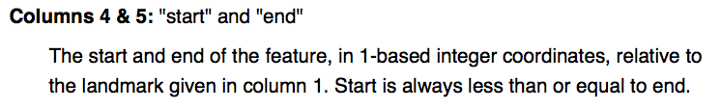
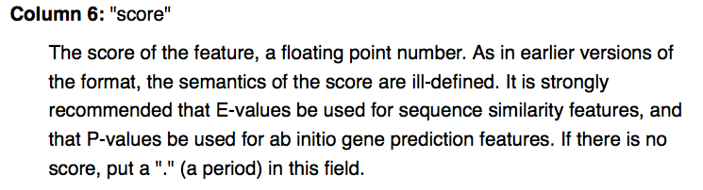
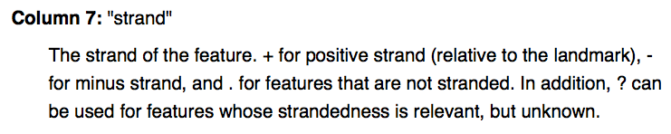

Slide 21
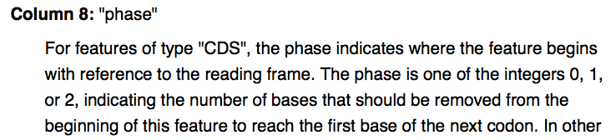
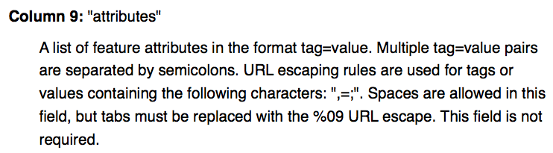

Slide 22
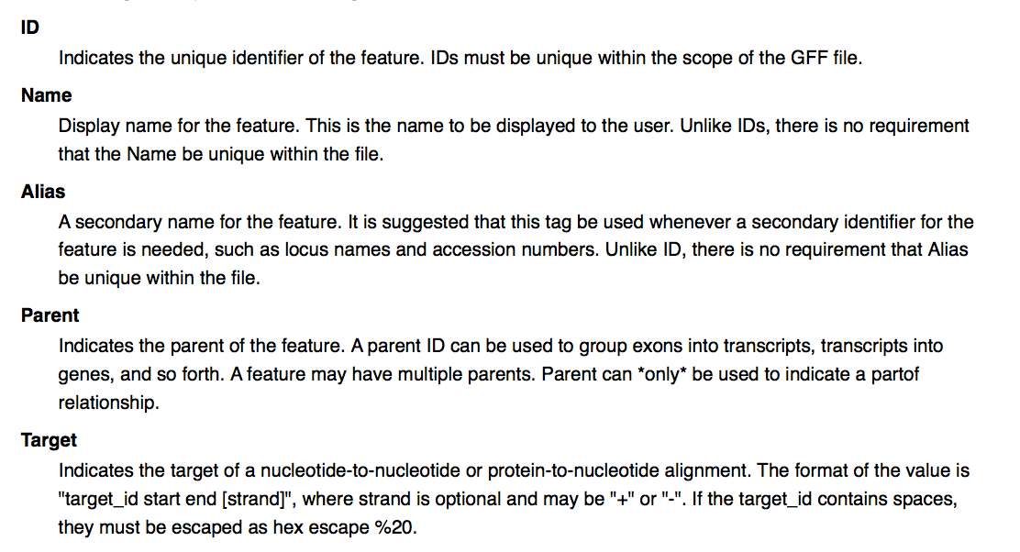
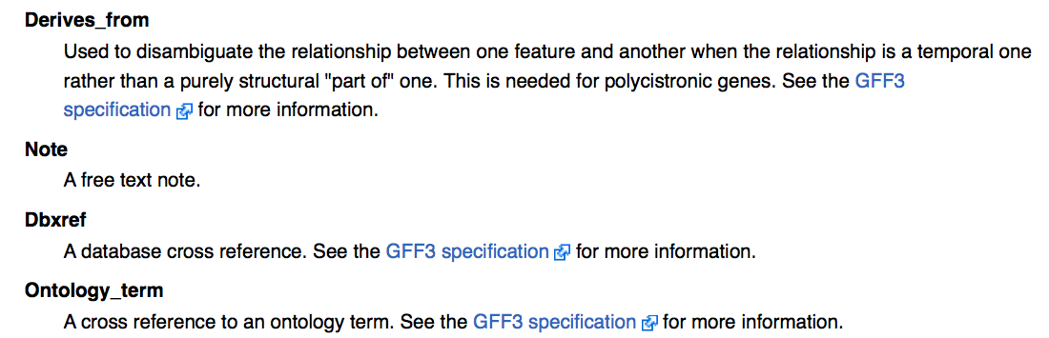

Slide 23
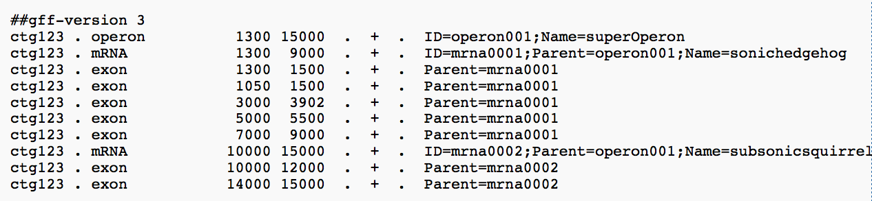
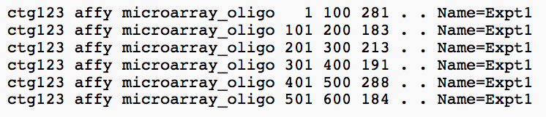
Example Annotation
Example Alignment
Example Microarray

Slide 24
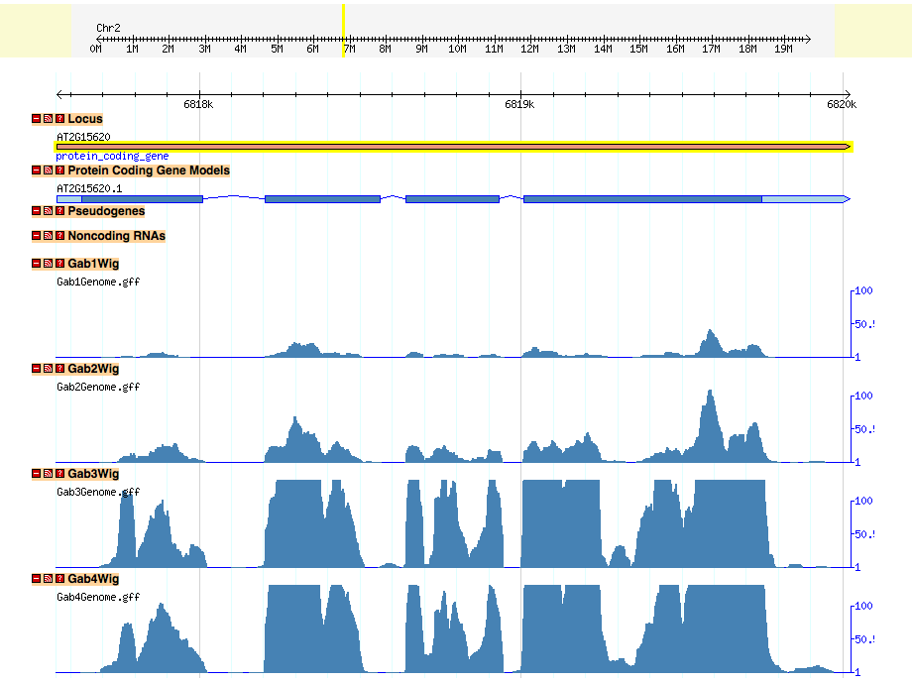
Viewing of Nitrogen Regulation of Nir1 (Nitrite Reductase) in Gbrowse
NO
Nitrate
PLUS
Nitrate

Slide 25
Links to browsers
UCSC genome browser
http://genome.ucsc.edu/cgi-bin/hgGateway
Gbrowse and BioMart
http://www.wormbase.org/db/gb2/gbrowse/c_elegans/
http://caprica.caltech.edu:9002/biomart/martview/a3f7caa6c6d06554448037f44317d7e1

Slide 26
Expression Databases
Manpreet S. Katari

Slide 27
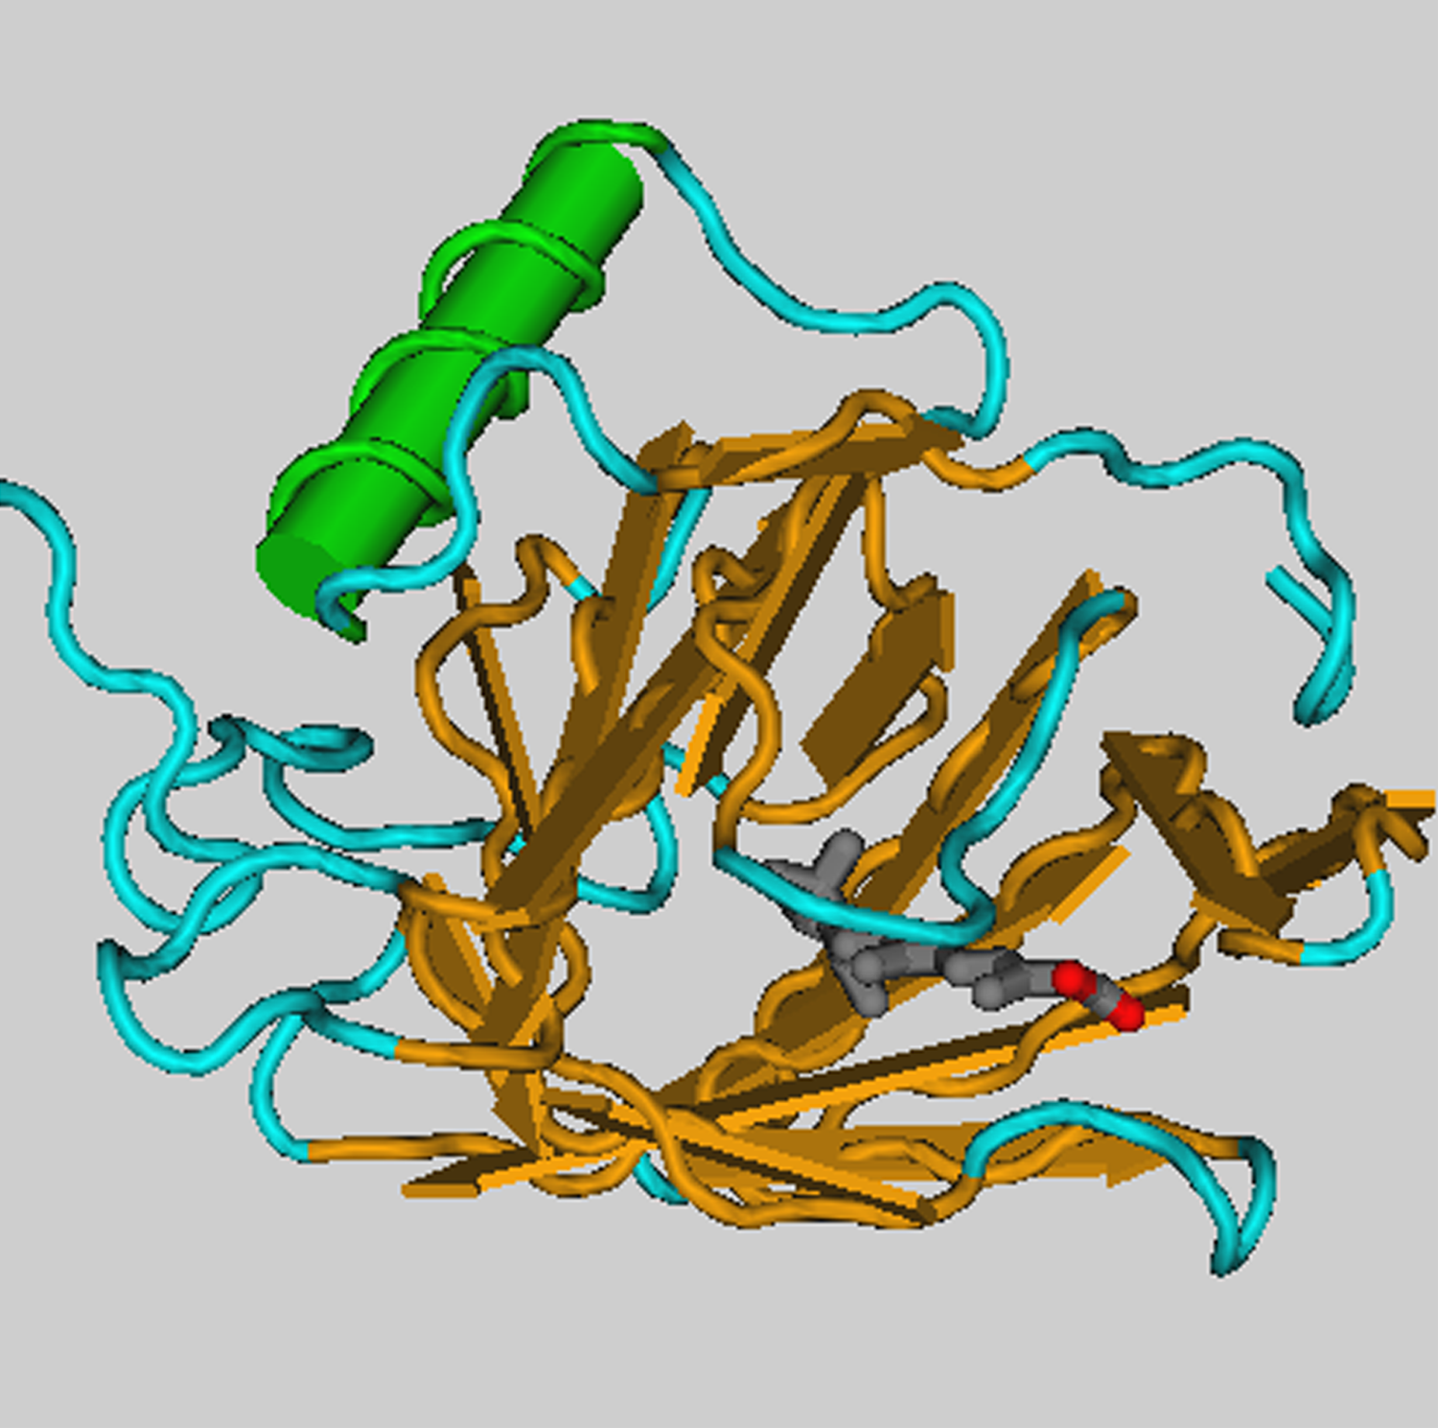
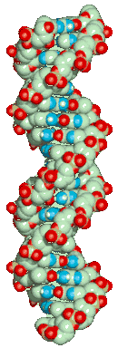
DNA
RNA
protein
phenotype
cDNA
Abundance of mRNA is what we try to measure

Slide 28
Questions that can be addressed with genome-wide expression analysis:
What genes have similar function?
What regulatory pathways exist?
Can we subdivide experiments or genes into meaningful classes?
Can we correctly classify an unknown experiment or gene into a known class?
Can we make better treatment decisions for a cancer patient based on his or her gene expression profile?

Slide 29
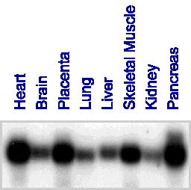
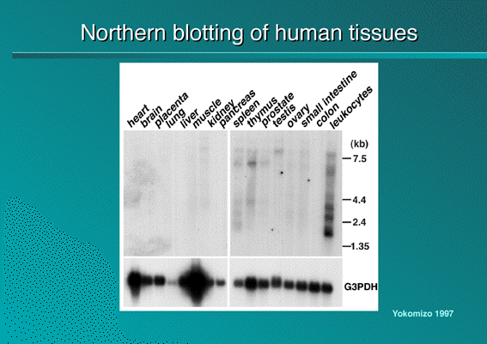
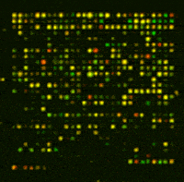
Microarrays vs Northern blots: from Gene to Genome Science
Northern blot: limited by number of lanes in gel
Microarray: A large number of DNA fragments are attached in a systematic way to a solid substrate, can measure mRNA levels for thousands of genes (~ every gene in a genome) in parallel
Notes:
Microarrays permit the simultaneous analysis of the RNA expression of thousands of genes. For fully sequenced genomes, microarrays can be used to analyze the expression of every gene. Northern blots, on the other hand, are limited by the number of lanes on the gel and by the number of probes that can be used on the same blot. Northern blots normally have 20–40 lanes, and no more than three probes can be used simultaneously. Thus, microarrays increase the throughput by several orders of magnitude.
DNA Microarrays are an extremely powerful tool. Whereas we have traditionally examines genes in isolation, DNA microarrays allow us to see all the genes of an cell working together in concert.
DNA Microarrays allow us to see the gene expression levels for tens of thousands of genes at once.
A microarray of 50,000 unique cDNAs allows the expression monitoring of the entire human genome in a single hybridization.

Slide 30
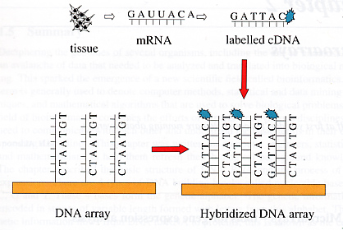
What is a microarray?

Slide 31
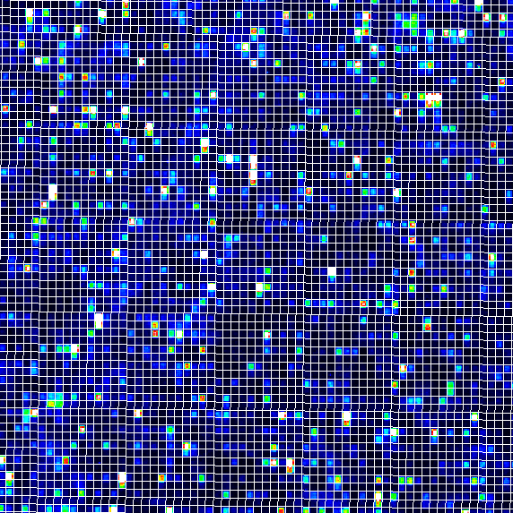
Microarrays
Provides the mRNA level of thousands of genes (sometimes almost all known genes in a genome) in a given sample
Sample=tissue (e.g., liver, brain), tissue in a specific environment or state (e.g., brain with cancer), etc.

Slide 32
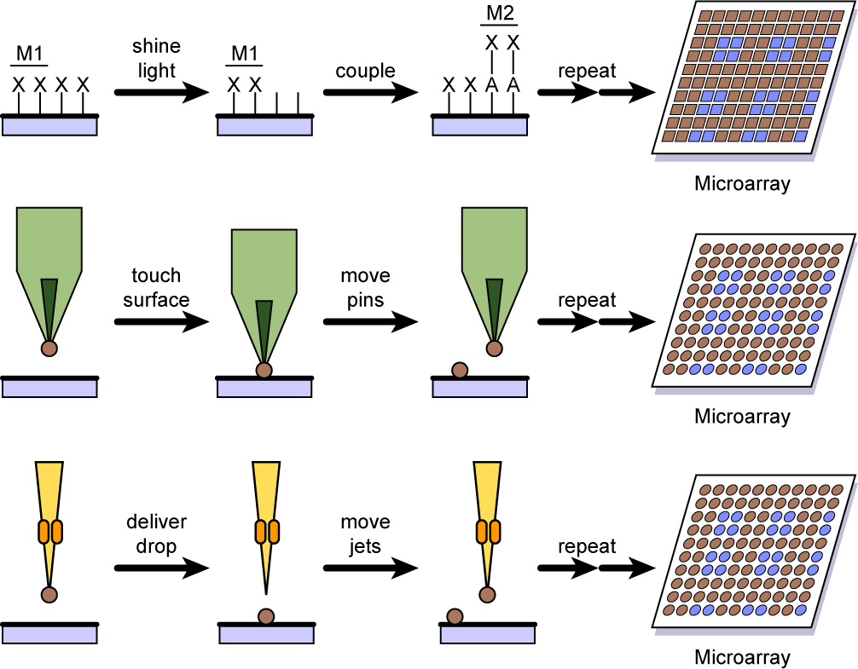
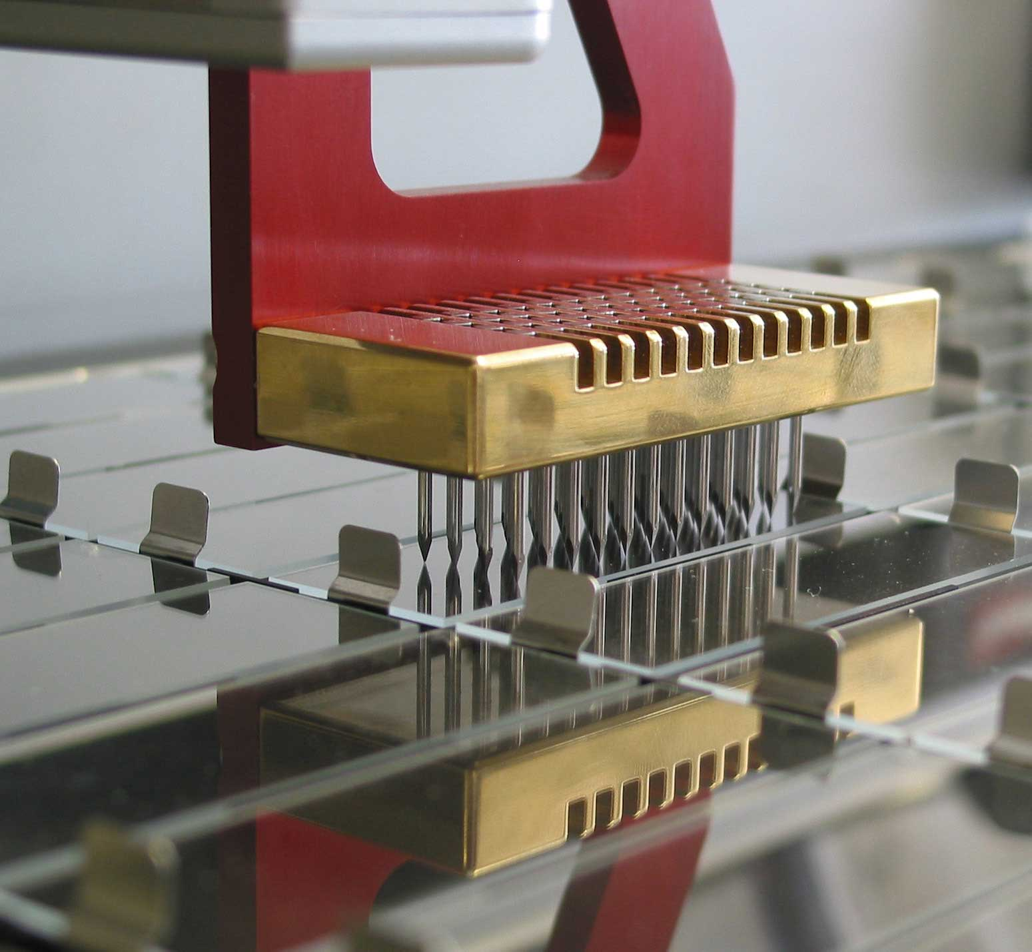
Spotted microarrays: how they are made
DNA mechanically placed on glass slide
Need to deliver nanoliter to picoliter volumes (too small for normal pipetting devices)
Robot “prints,” or “spots,” DNA in specific places
DNA spotting usually uses multiple pins
DNA in microtiter plate
DNA usually PCR amplified
Notes:
Different technologies are being used for the production of microarrays. The most commonly used microarray technologies are mechanical spotting and photolithography. Mechanical spotting involves placing very small quantities of DNA on glass slides. The volumes of liquid in which the DNA is suspended are in the nanoliter to picoliter range, which is too small for normal pipetting devices. Robots have been adapted to handle these small volumes and to “spot” or “print” them at precisely determined locations on glass slides.
Most robotic spotters use pins that act by capillary action similar to that of fountain pens. Multiple pins are mounted together and dipped simultaneously into DNA aliquoted into the different wells of a microtiter plate. The DNA in the wells has usually been amplified from cDNA or genomic DNA, using PCR. Oligonucleotides can also be spotted in this way.

Slide 33
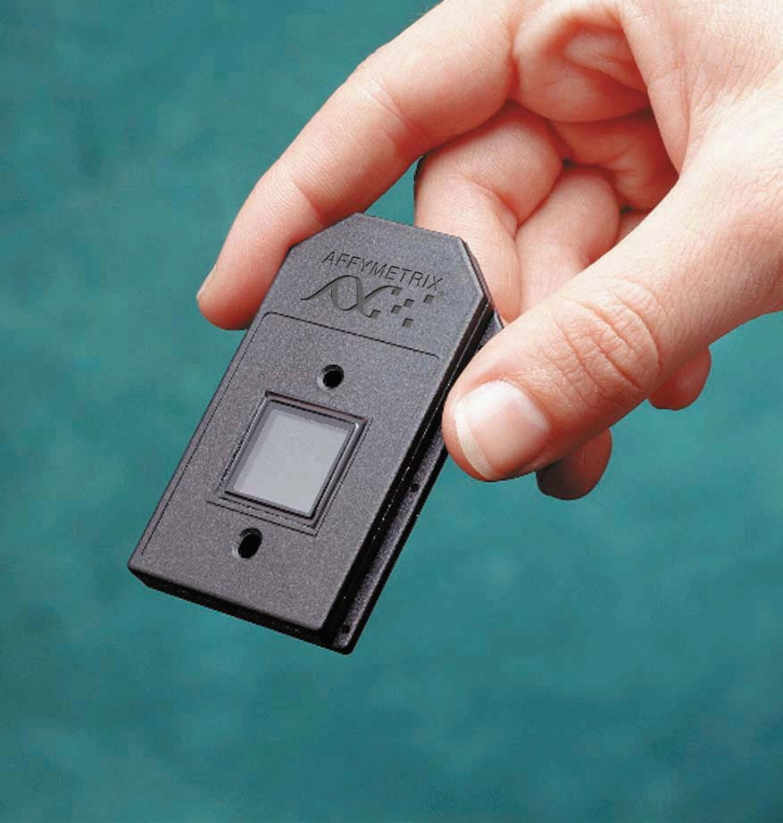
Affymetrix gene chip

Slide 34
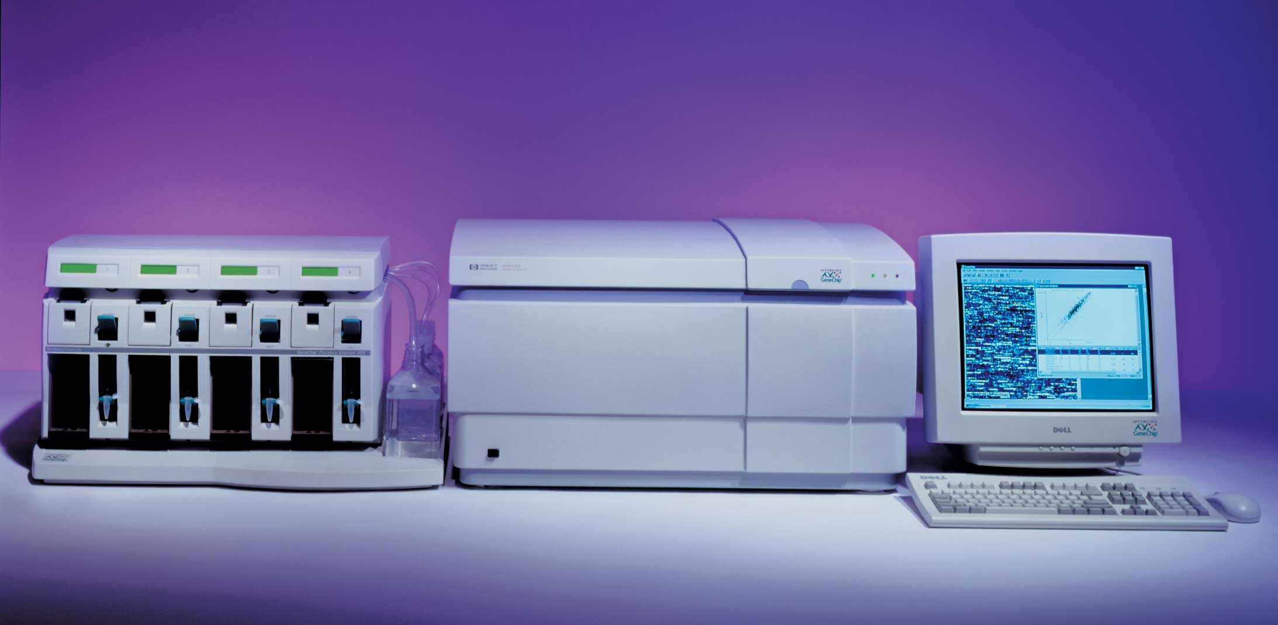
Affymetrix system

Slide 35
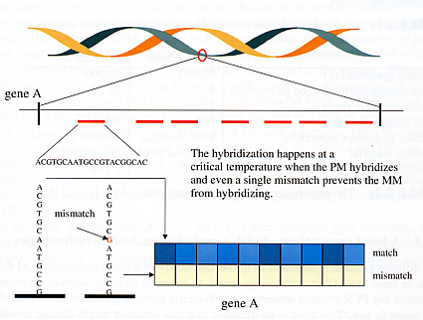
Affymetrix Array

Slide 36
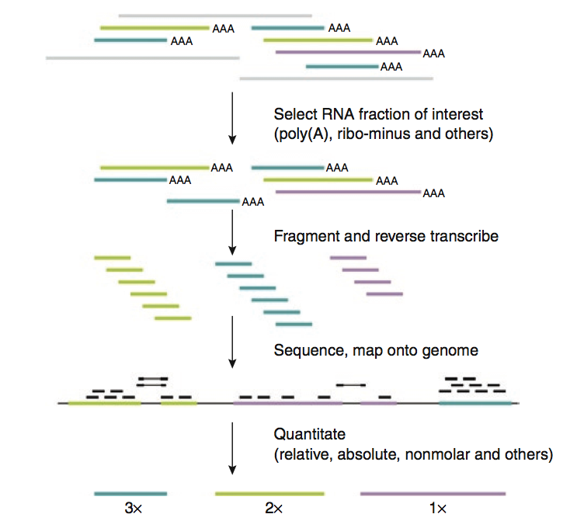
Transcriptomics using RNA-seq
Notes:
Figure 5 | Overview of RNA-seq. A RNA fraction of interest is selected, fragmented and reverse transcribed. The resulting cDNA can then be
sequenced using any of the current ultra-high-throughput technologies to obtain ten to a hundred million reads, which are then mapped back onto the
genome. The reads are then analyzed to calculate expression levels.

Slide 37
Gene expression can be assayed across many different conditions
Experiment 1
Experiment 2
Experiment 3
Experiment 4
Experiment 5
Experiment 6
Experiment 7
Experiment 8
Experiment 9
Experiment 10
Gene 1
> 8.0
Gene 2
> 4.8
> 2.8
Gene 3
> 1.7
Gene 4
1:1
Gene 5
> 1.7
…
…
> 2.8
> 4.8
Gene 10,000
> 8.0
A separate microarray experiment is performed using mRNA isolated from each different “condition”, e.g.:
Developmental time course
Time course after exposure to some environmental stimulus (chemical, light/dark, etc.)
Different tissues
Normal vs. diseased tissue

Slide 38
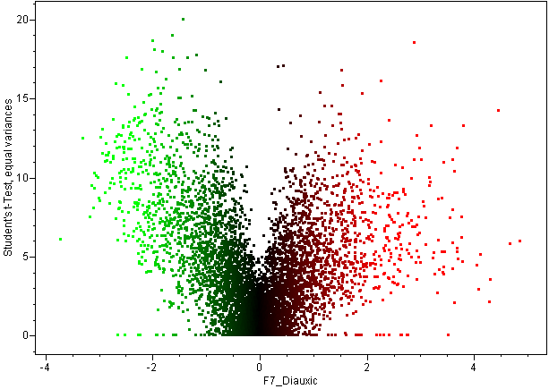
Volcano plot fold-change vs. significance
p=10⁻¹⁸
-log (p-value)
p=10⁻³
p=10⁻²
Log ratio
Notes:
A volcano plot is a scatter plot of -log (p-value) from a t-test or one-way ANOVA, versus log ratio. It allows you to visualize fold-change and statistical significance at the same time, so that one can find genes that are significant and have large fold change, or genes that are significant but have small fold change.

Slide 39
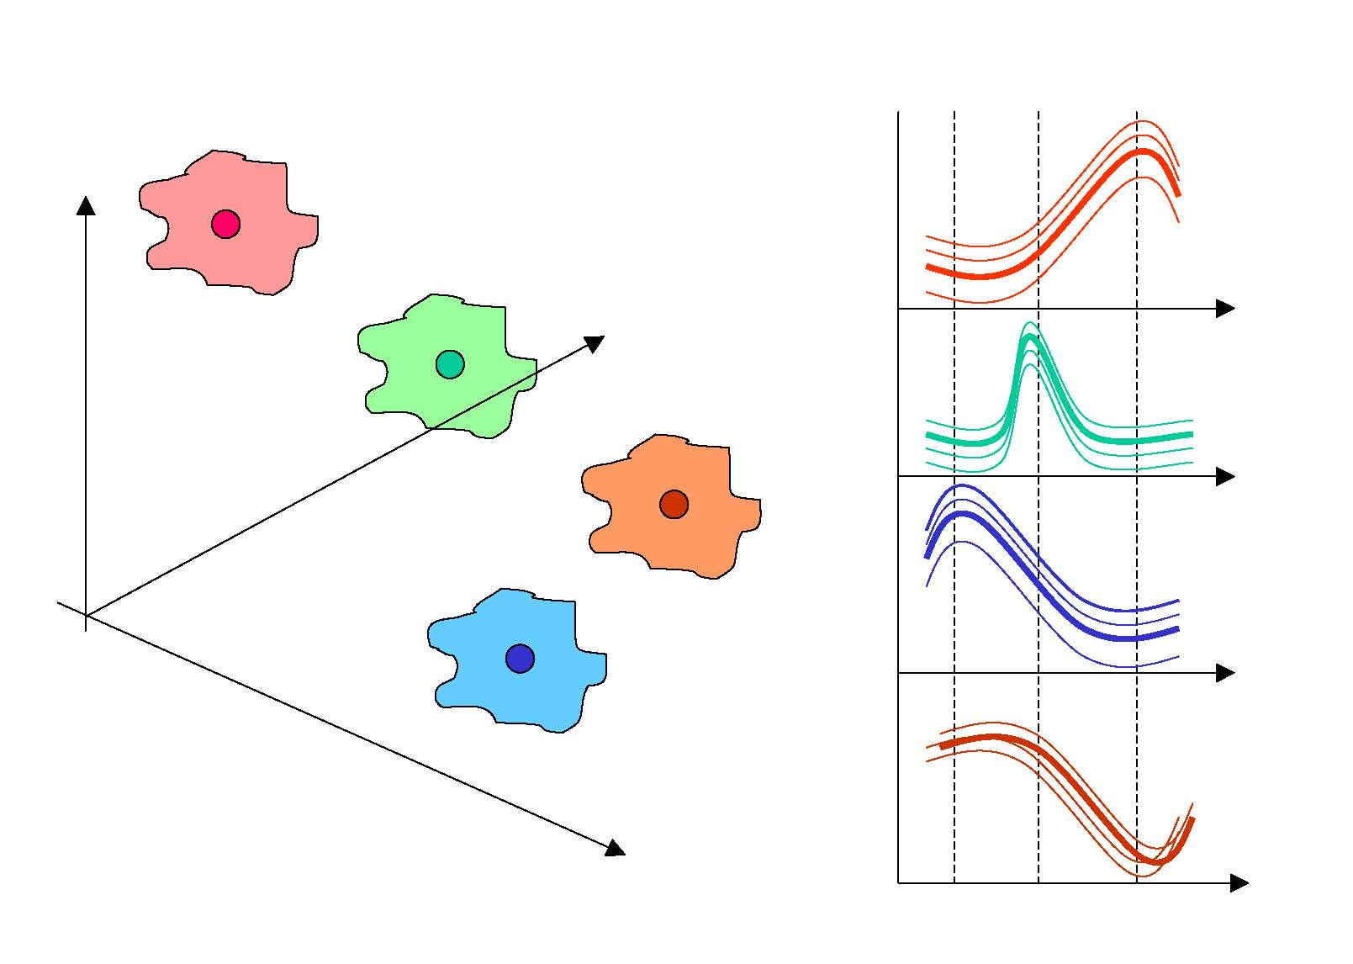
Clustering (genes)
p points in a T-dimensional space ( p = # of genes, T = # of conditions )
based on proximity of the points:
Extract a few typical expression patterns (cluster centroids)
Partition genes based on their profile similarity (clusters, memberships)
Genes with similar expression profiles are likely to have common or related functions, and possibly to be co-regulated
T = 3
Similarly, conditions can be classified into different groups based on similarities in their expression profiles (all or subsets of genes).

Slide 40
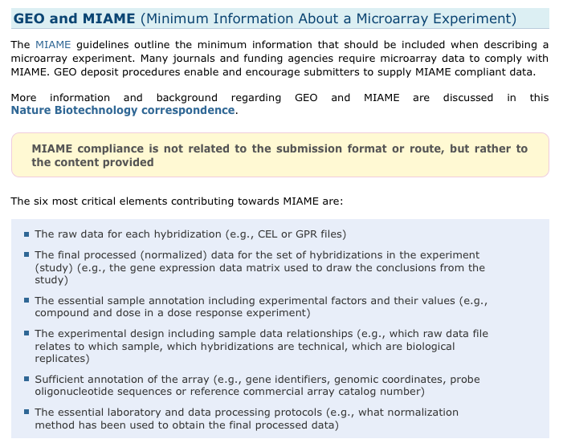
Standard Format (MIAME)
http://www.ncbi.nlm.nih.gov/geo/info/MIAME.html

Slide 41
Common Databases
Microarray Data
NCBI GEO (Gene Expression Omnibus)
ArrayExpress
RNA-seq
NCBI SRA (Sequence Read Archive)
ENA (European Nucleotide Archive)

Slide 42
Gene Expression Omnibus Repository (GEO)
http://www.ncbi.nlm.nih.gov/geo/
Platform – information regarding the technology used (GPLXXXX)
Sample – information submitted by the experimenter regarding the conditions and manipulations (GSMXXXX)
Series – Samples are linked with series which defines the entire dataset (GSEXXX)
GEO Dataset – GEO sample information collected by GEO staff. Can be used to compare with other datasets.

Slide 43
GEOquery Package
>source(“http://bioconductor.org/biocLite.R”)
>biocLite(“GEOquery”)
>library(“GEOquery”)
>gds<-getGEO(“GDS2084”)
>Meta(gds)
>head(Table(gds))
>Columns(gds)
>gsm<-getGEO(“GSM114841”)
>Meta(gsm)
>Columns(gsm)
>head(Table(gsm)

Slide 44
Different Utilities for Deep-Seq
RNA-seq
Sequencing equivalent to Microarray data
Method for discovering new RNA molecules
Method for quantifying RNA abundance
CHIP-seq (Chromatin Immuno Precipitation)
Method for indentifying region of genome where a particular protein is binding.
Transcription Factors
Histone Modifications

Slide 45
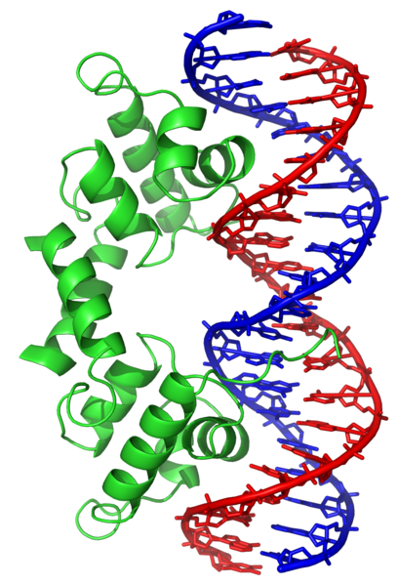
Transcription Factors
http://en.wikipedia.org/wiki/DNA_binding_protein

Slide 46
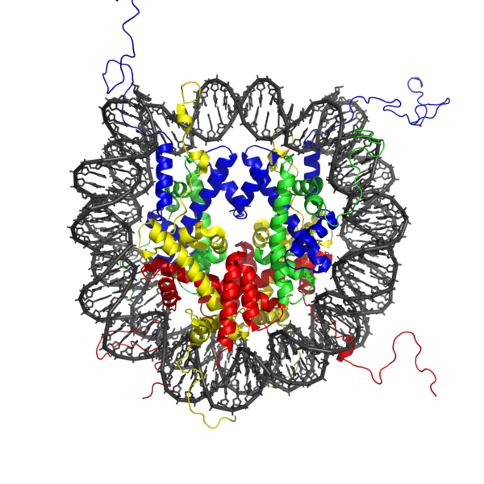
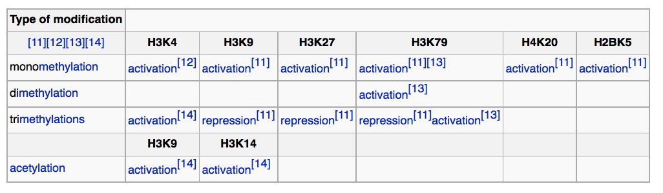
Histone Modification
http://en.wikipedia.org/wiki/Nucleosome

Slide 47

CHIP-chip
http://en.wikipedia.org/wiki/ChIP-on-chip

Slide 48

Regions of the genome that are enriched for sequences are areas where protein interacts

Slide 49

CHIP-seq: same idea but sequencing instead of hybridization.

Slide 50

Connecting to the SRA database
SRA database : http://www.ncbi.nlm.nih.gov/sra

